Slide 1
Course 8
Software Quality Scales, Evaluations and Tools

Slide 2
Measurements
Nominal scale
Ordinal scale
Interval scale
Ratio scale
Notes:
Nominal: female / male
Ordinal – suggest order: satisfactory, good, very good, outstanding
Interval: range [1,20]
Ratio: height, weight

Slide 3
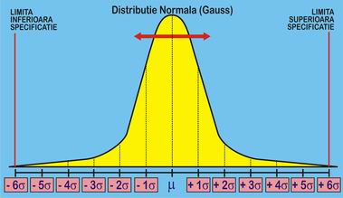
Basic measures
Ratio
Proportion
Percentage
Rate
Six sigma
Quality level
Motorola, 1986
Value = defect rate = 3.4 defective parts / milion

Slide 4
SQ metrics
Subset of software metrics – focus on quality
Def 1: A quantitative measure of the degree to which an item possesses a given quality attribute.
Def 2: A function whose inputs are software data and whose output is a single numerical value that can be interpreted as the degree to which the software possesses a given quality attribute.
Result
Process

Slide 5
Objectives
Management control: planning + execution
Deviations from functional performance
Deviation from resources performance (time, people)
Identify situations for improvement
Reports, statistics based on metrics’ information
SQ metrics incorporated in project management tools

Slide 6
How is used
Comparison with indicators:
Defined software quality standards
Quality targets set for organizations or individuals
Previous year’s/ project’s quality achievements
Average quality levels achieved by other teams
Average quality achievements of the organization

Slide 7
Classification
Process metrics
Software development process
Product metrics
Software maintenance
Classification
Quality
Timetable
Effectiveness (of error removal and maintenance services)
Productivity

Slide 8
Software Development Process Metrics
Software process quality metrics
Error density metrics
Error severity metrics
Software process timetable metrics
Development Productivity
Function point Develop. Productivity
Software process productivity metrics
Error removal effectiveness metrics
Time Table Observance
Average Delay of Milestone Complet.
Development Errors Removal Effectiveness
Development Weighted Errors Removal Effectiveness
Code Reuse

Slide 9

Example 1
Error severity metrics:
ASCE (Average Severity of Code Errors)
Data collected from code inspection and testing reports

Slide 10
Example 2 (SQ+PM)
Technical debt = describes the consequences of software development actions that intentionally or unintentionally prioritize client value and/or project constraints such as delivery deadlines, over more technical implementation and design consideration [cit]
Signs for:
Code smells
High complexity
Product bugs
Coding style
SonarQube https://docs.sonarqube.org/display/SONARQUBE52/Technical+Debt

Slide 11
Implementation of SQ Metrics
Definition of SQ metrics
Relevant and adequate – teams, depart., projects
Application – management
Process [Galin]
Statistical analysis of collected data
Definition of attributes to be measured
Definition of the metrics
Determination of comparative target values
Reporting and data collection method
Agile
Notes:
Agile – redefine – research problem

Slide 12
Example 1. Motorola
Daskalantonakis, M. K., "A Practical View of Software Measurement and Implementation Experiences Within Motorola (1001–1004)," IEEE Transactions on Software Engineering, Vol. 18, No. 11 (November 1992): 998–1010. Copyright © IEEE, 1992
Establish 7 goals
Establish measurement areas
Goal ⇒question
Answer ⇒ metric
Project planning, software productivity

Slide 13
Example 2. Hewlett-Packard
Grady, R. B., and D. L. Caswell, Software Metrics: Establishing A Company-Wide Program, pp. 225–226. Englewood Cliffs, N.J.: Prentice-Hall
Primitive + computed metrics
12 metrics

Slide 14
Tools
Software metrics tools
!!! Software quality
List

Slide 15
7 Basic Quality Tools
Ishikawa (1989)
Quality control
statistical tools for process and quality control
project and organization level
useful for project leaders and process experts.
do NOT provide specific information to software developers on how to improve the quality of their designs or implementation.

Slide 16
1. Checklist/ check sheet
Gathering and arranging data + confirmation
Types:
design review checklist
code inspection checklist
Example: Requirement checklist
How to use it?
1. Decide what event or problem will be observed. Develop operational definitions.
2. Decide when data will be collected and for how long.
…
When to use it?
When data observed and collected repeatedly
When collecting data from a production process.

Slide 17
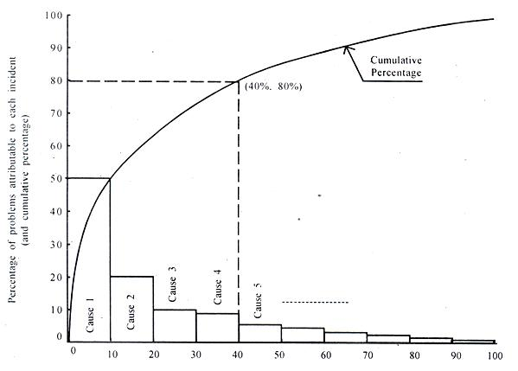
2. Pareto Diagram
X axis = defect cause
Y axis = defect count
Pareto analysis: 80-20%
How to use it?
1.Decide categories to group items.
2. Decide measurement: frequency, quantity, cost and time.
3. Decide period of time
4. Collect the data, recording the category each time.
5. Subtotal the measurements for each category.
6. Determine the appropriate scale for the measurements you have collected. The maximum value will be the largest subtotal from step 5. Mark the scale on the left side of the chart.
7. Construct and label bars for each category. Place the tallest at the far left, and so on.
When to use it?
When analyzing data about the frequency of problems or causes in a process.
When analyzing causes by looking at their specific components.
When communicating with others about your data.

Slide 18
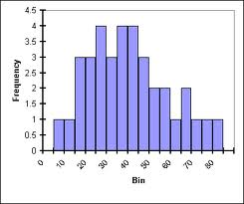
3. Histogram
graphic representation of frequency
X-axis lists the unit intervals of a parameter
Y-axis contains the frequency counts.
order of X variable, (Pareto diagram - order of the frequency counts)
show the distribution characteristics of a parameter
When to use it?
When the data are numerical.
When you want to see the shape of the data’s distribution, especially when determining whether the output of a process is distributed approximately normally.
When analyzing whether a process can meet the customer’s requirements.
How to use it?
Collect at least 50 consecutive data points from a process.
Analyze shape and meaning

Slide 19
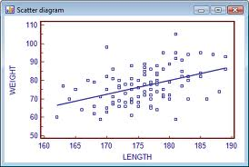
4. Scatter diagram
When to use it?
When you have paired numerical data.
When your dependent variable may have multiple values for each value of your independent variable.
When trying to determine whether the two variables are related
How to use it?
Collect pairs of data where a relationship is suspected.
Look at the pattern of points to see if a relationship is obvious. If the data clearly form a line or a curve, you may stop. The variables are correlated.
You may wish to use regression or correlation analysis now.
the relationship of two interval variables
X-axis = independent variable
Y-axis = dependent variable
Each point in a scatter diagram represents an observation of both the dependent and independent variables
help data-based decision making

Slide 20
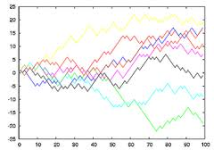
5. Run chart
tracks the performance of parameter over time
X-axis = time
Y-axis = value of the parameter.
used for trend analysis
pie chart, bar graph, circle graph [Ishikawa]
How to use it?
Consider which information about the sources of the data might have an effect on the results
Analyze the subsets of stratified data separately: draw quadrants, count points and determine the critical value for each set of data
When to use it?
Before collecting data.
When data come from several sources or conditions,
when following the data in time / space

Slide 21
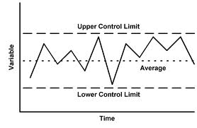
6. Control chart
advanced form of a run chart
central line, a pair of control limits
X-axis = real time.
If all values of the parameter are within the control limits and show no particular tendency => controlled state.
If values outside the control limits or indicate a trend => out of control
How to use it?
1. Choose the appropriate control chart for your data.
2. Determine the appropriate time period for collecting and plotting data.
3. Collect data, construct your chart and analyze the data.
4. Look for “out-of-control signals” on the control chart. When one is identified, mark it on the chart and investigate the cause
When to use it?
When controlling ongoing processes by finding and correcting problems as they occur.
When predicting the expected range of outcomes from a process.
When determining whether your quality improvement project make fundamental changes to the process.

Slide 22
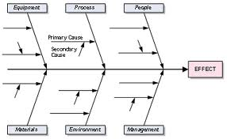
7. Cause-and-effect diagram
(fishbone diagram)
shows the relationship between a quality characteristic and factors that affect that characteristic
identifies all causal factors of a quality characteristic in one chart
How to use it?
Agree on a problem statement (effect)
Brainstorm the major categories of causes of the problem. If this is difficult use generic headings
3. Write the categories of causes as branches from the main arrow.
4. Brainstorm all the possible causes of the problem.
When to use it?
When identifying possible causes for a problem.
Especially when a team’s thinking tends to fall into ruts.
Agile

Slide 23
Recommendation for project
Use a type of diagram for software quality evaluation

Slide 24
SWOT analysis
Internal factor
Advantage, qualities
Internal factor
Things to improve,
Strenghts
Weaknesses
Opportunities
Threats
External factor
Context, trend
External factor
Obstacles, challenges

